Slide 1



Good afternoon.

Slide 2

Look at the clock. Ask and answer about the time

Slide 3
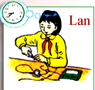


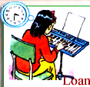
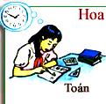
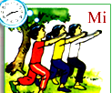
Look at pictures and write subjects in 2’
10.10
9.20
Physics
Geography
English
3.30
1.50
2.40
Music
Math
Physical Eduacation

Slide 4

Unit 4: A4- A5
4. Look at the pictures. Ask and answer questions
8.40
What is Lan studying?
Lan is studying physics
What time does Lan have her physics class?
She has her physics class at 8.40
10.10
9.20

Slide 5
4. Look at the pictures. Ask and answer questions
8.40
What is Lan studying?
Lan is studying physics
What time does Lan have her physics class?
She has her physics class at 8.40C
1.50
3.30
2.40

Slide 6
NEW WORDS:
1. Technology
Môn kỹ thuật, công nghệ
2. Biology
Môn sinh
3. Chemistry
Môn Hóa
4. Civic
công dân
Civic Education
Môn Giáo dục công dân
5. Fine Arts
Môn Họa
6. Elective Subject
Môn tự chọn
7. Science
Môn khoa học
8. assemble
tập hợp
School assemble
Chào cờ
9. Class meeting
Sinh hoạt lớp

Slide 7
Unit 4: A4- A5
5.Listen and read.
Hoa: When do you have English?
Thu: I have English classes on Wednesday and Thursday.
Hoa: What time do they start?
Thu: My first English class is on Wednesday at 8.40. On
Thursday I have English at 9.40.
Hoa: What other classes do you have on Thursday?
Thu: I have Math, Geography, Physical Education and Music.
Hoa: What’s your favorite subject, Thu?
Thu: I like History. It ‘s an interesting and important subject.
Hoa: Yes, I like it, too.
Thu: What’s your favorite subject?
Hoa: Oh, Math. It’s difficult, but fun.

Slide 8

MODEL SENTENCE
What’s your favorite subject?
I like ……
Or:
My favorite subject is ……….
Ex:
I like History
My favorite subject is Math

Slide 9


Write your schedule in your exercise book.
Then ask and answer questions about schedule with a partner
MONDAY
TUESDAY
WEDNESDAY
THURSDAY
FRIDAY
SATURDAY
I have English classes on Wednesday and Thursday.
I have Math, Geography, Physical Education and Music.
When do you have English?
I like History and Math
What other classes do you have on Thursday?
What’s your favorite subject?
Class meeting

Slide 10
Homework
- Practice A5 again
Learn by heart the subjects.
Do exercises A3,4,5,6 in workbook.
Prepare A6 (page 44. )

Slide 11


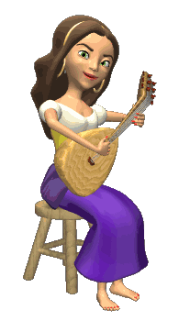

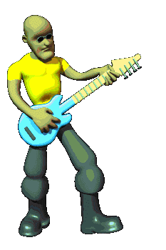
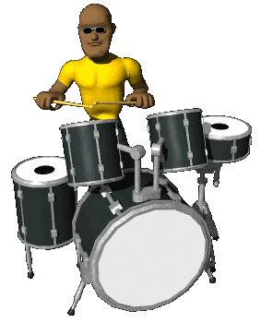

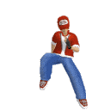



THANK YOU FOR ATTENTION!
GOOD BYE!
the end

